Slide 1

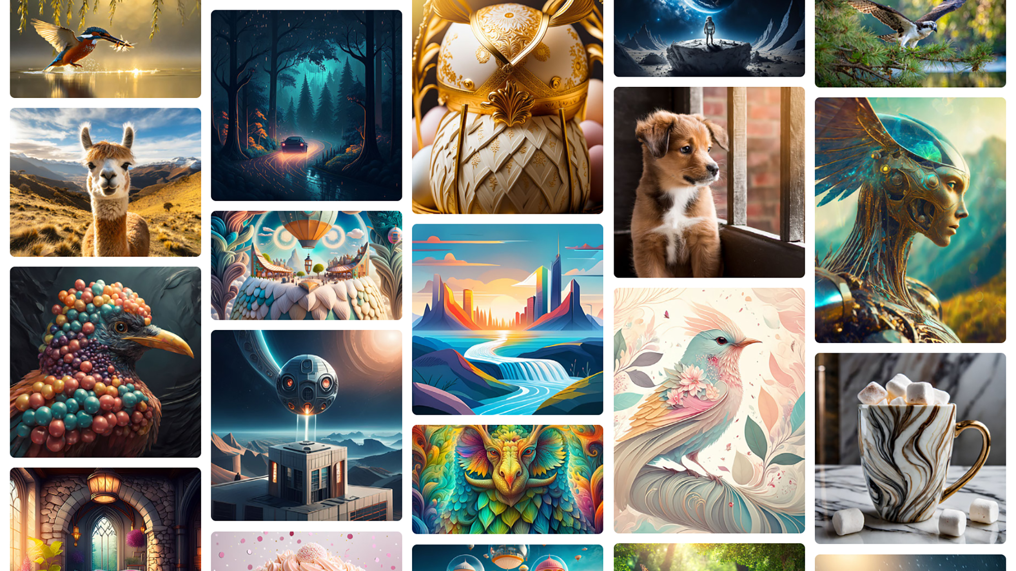


Text-to-Image Generation with Deep Learning Models: Exploring the Potential of VQGAN and CLIP
Thesis Presentation :
Subrat Kumar Nanda
Roll No. 22DS011003

Slide 2
Abstract
Challenge : Generating realistic images and videos from text descriptions is difficult in AI.
Innovative Approach: Uses CLIP for multimodal understanding and Transformers for sequence generation.
CLIP Model: Embeds text and image in a shared space for effective cross-modal matching.
Transformers: Generate coherent and diverse outputs across static and dynamic visuals.
Unified Framework: Combines CLIP and Transformers to enhance AI-driven multimedia generation.
Novel Method : Uses a pretrained joint image-text encoder to guide an image generative model.
Loss Function: Multimodal encoder evaluates text-image similarity and backpropagates to the image generator.
Generation vs. Editing : Generates from random noise or edits specific images based on text input.
No Additional Training: Relies solely on pretrained models, unlike methods that require training from scratch.
Advancement: Offers a more efficient approach to generating and editing images from text, advancing the state-of-the-art in AI multimedia generation.
Reference: Liu et al., Ramesh et al., and Nichol et al.

Slide 3
Introduction
Generating or manipulating high-quality images from text is challenging, requiring a strong link between visual and textual representations. Previous methods like Open-Edit enabled simple text-based image manipulations but didn't support image generation. Models like DALL-E and GLIDE introduced generation from text prompts but lacked image manipulation capabilities.
The synthesis of visual content from textual descriptions is a crucial area in AI, with applications in digital content creation, virtual environments, and interactive media. Recent advancements in deep learning, particularly with multimodal models like CLIP and generative models like Transformers, offer promising solutions. CLIP's pre-training allows it to effectively encode semantic information from text and retrieve visual representations. Transformers' attention mechanisms capture intricate patterns, making them ideal for generating high-quality visual and video outputs.
This research explores integrating CLIP and Transformer architectures to enhance the quality, diversity, and contextual relevance of generated multimedia content. By leveraging CLIP's multimodal understanding and Transformers' generative capabilities, we aim to advance AI-driven creativity, enabling systems to interpret nuanced textual descriptions and produce visually compelling outputs.

Slide 4
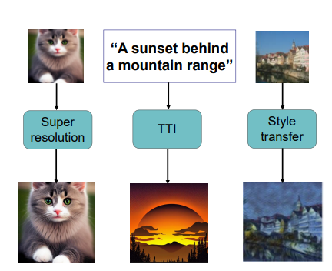
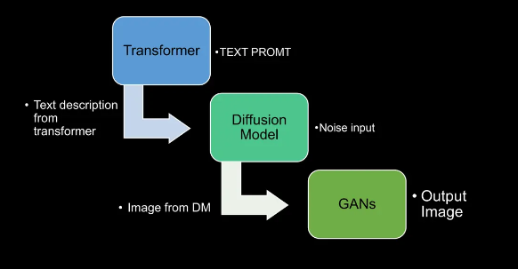
AI Image generation
Super-resolution enhances the image by adding more details and generates the output with high fidelity.
Style change transfers the image to another domain with mutual information.
Text-to-image generates high quality images that are well aligned with user input.

Slide 5
Motivation & Literature Survey
Motivation
Transformative AI Models: Aim to generate complex multimedia content from textual prompts.
Current Challenges: Existing models struggle with semantic coherence and fidelity.
Integration Approach: Combining CLIP and Transformers to overcome these challenges.
Applications: Potential to revolutionize personalized content creation, interactive storytelling, and immersive experiences.
Literature Review
Pre-Training Methods in NLP and CV
NLP Advances: Autoregressive and masked language modeling have significantly improved NLP capabilities (Dai & Le, 2015; Peters et al., 2018; Howard & Ruder, 2018; Radford et al., 2018; Devlin et al., 2018; Raffel et al., 2019).
Task-Agnostic Models: Standardized "text-to-text" interfaces and models like GPT-3 (Brown et al., 2020) enable zero-shot transfer and outperform specialized models.
Early Efforts and Recent Advances
Image Representation Learning: Techniques evolved from Mori et al. (1999) to Li et al. (2017), incorporating multimodal and CNN-based methods for predicting text from images.
Transformer-Based Models: VirTex, ICMLM, and ConVIRT demonstrate the potential but lag in performance on benchmarks like ImageNet.

Slide 6
Cont…
Targeted Weak Supervision
Improved Performance: Mahajan et al. (2018) showed Instagram hashtag prediction boosts accuracy. Kolesnikov et al. (2019) and Dosovitskiy et al. (2020) achieved gains using the JFT-300M dataset.
Comparison and CLIP's Contributions
Balancing Supervision: Combining supervised "gold-labels" and raw text.
Scale Differences: Earlier models trained on billions of images, newer models like CLIP trained on fewer images but more efficiently.
CLIP's Efficiency: Uses 400 million (image, text) pairs, scales predictably with compute, and achieves competitive performance across tasks.
Versatility: CLIP performs OCR, geo-localization, and action recognition, demonstrating robustness and efficiency.

Slide 7
Proposed Approach for Semantic Image Generation and Editing
Unified Approach: Combines a pretrained joint image-text encoder with an image generative model.
Methodology:
Uses the multimodal encoder to define a loss function evaluating (text, image) pair similarity.
Iteratively updates the latent space of the image generator to minimize this loss.
Generation vs. Editing:
For generation, initialize with random noise.
For editing, initialize with a specific image.
Advantages:
No additional training required.
Utilizes existing pretrained models.
More efficient than methods requiring training from scratch (e.g., Liu et al., Ramesh et al., Nichol et al.).
Contributions of our methodology :
High Visual Quality
Semantic Fidelity
Efficiency:
Open Development and Research
Propose Model:
Text to Image Synthesis Using Multimodal (VQGAN + CLIP) Architectures

Slide 8
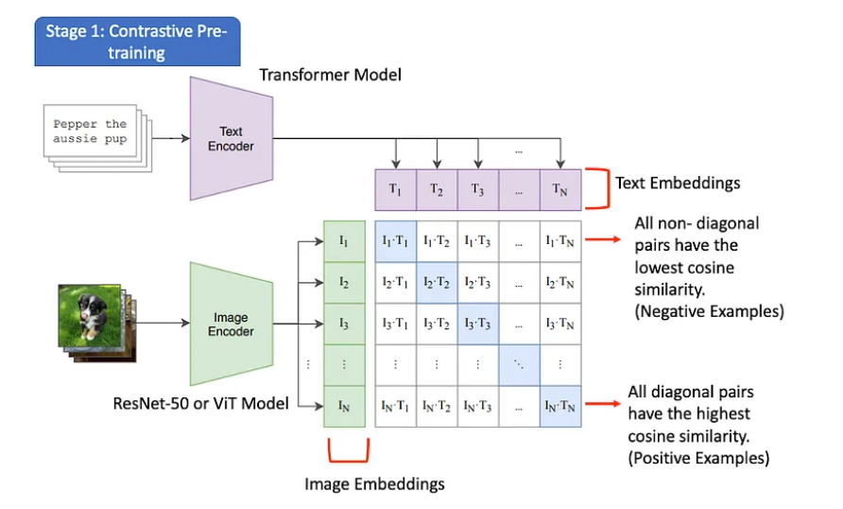
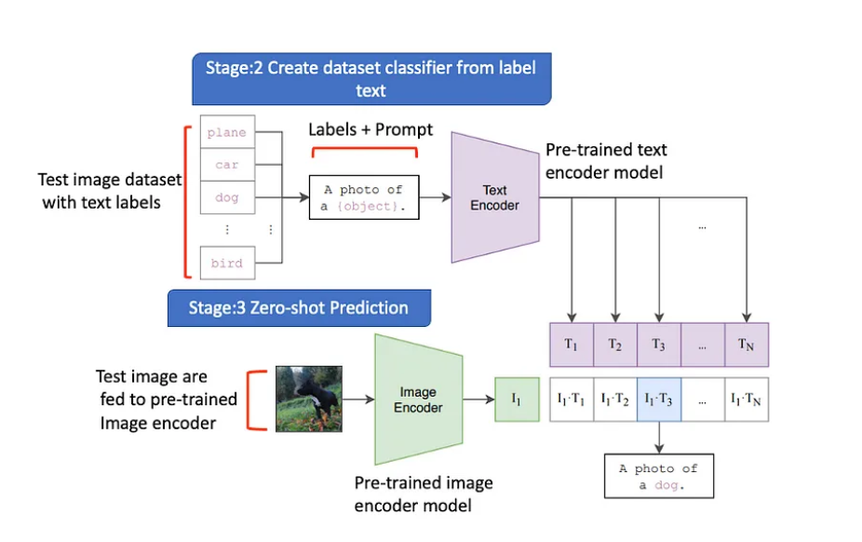
CLIP (Contrastive Language-Image Pre-training)
DataSet:
Size: 400 million (image, text) pairs.
Source: Collected from publicly available internet data.
Variety: Includes diverse content types and linguistic expressions,
providing a rich source of supervision across many visual concepts.

Slide 9
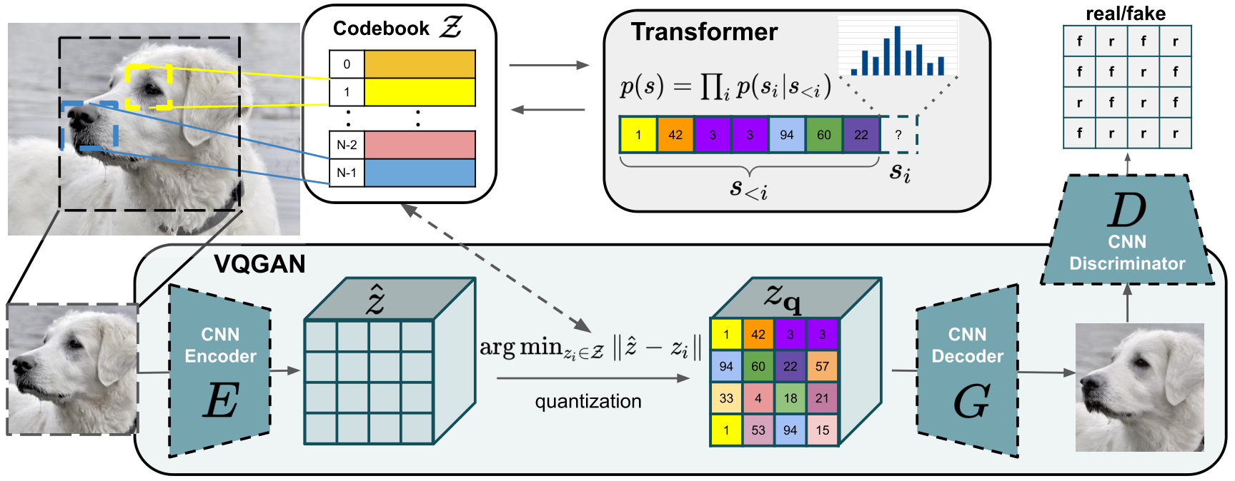
VQGAN (Vector Quantized Generative Adversarial Network)

Slide 10
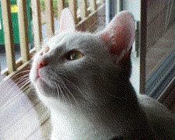
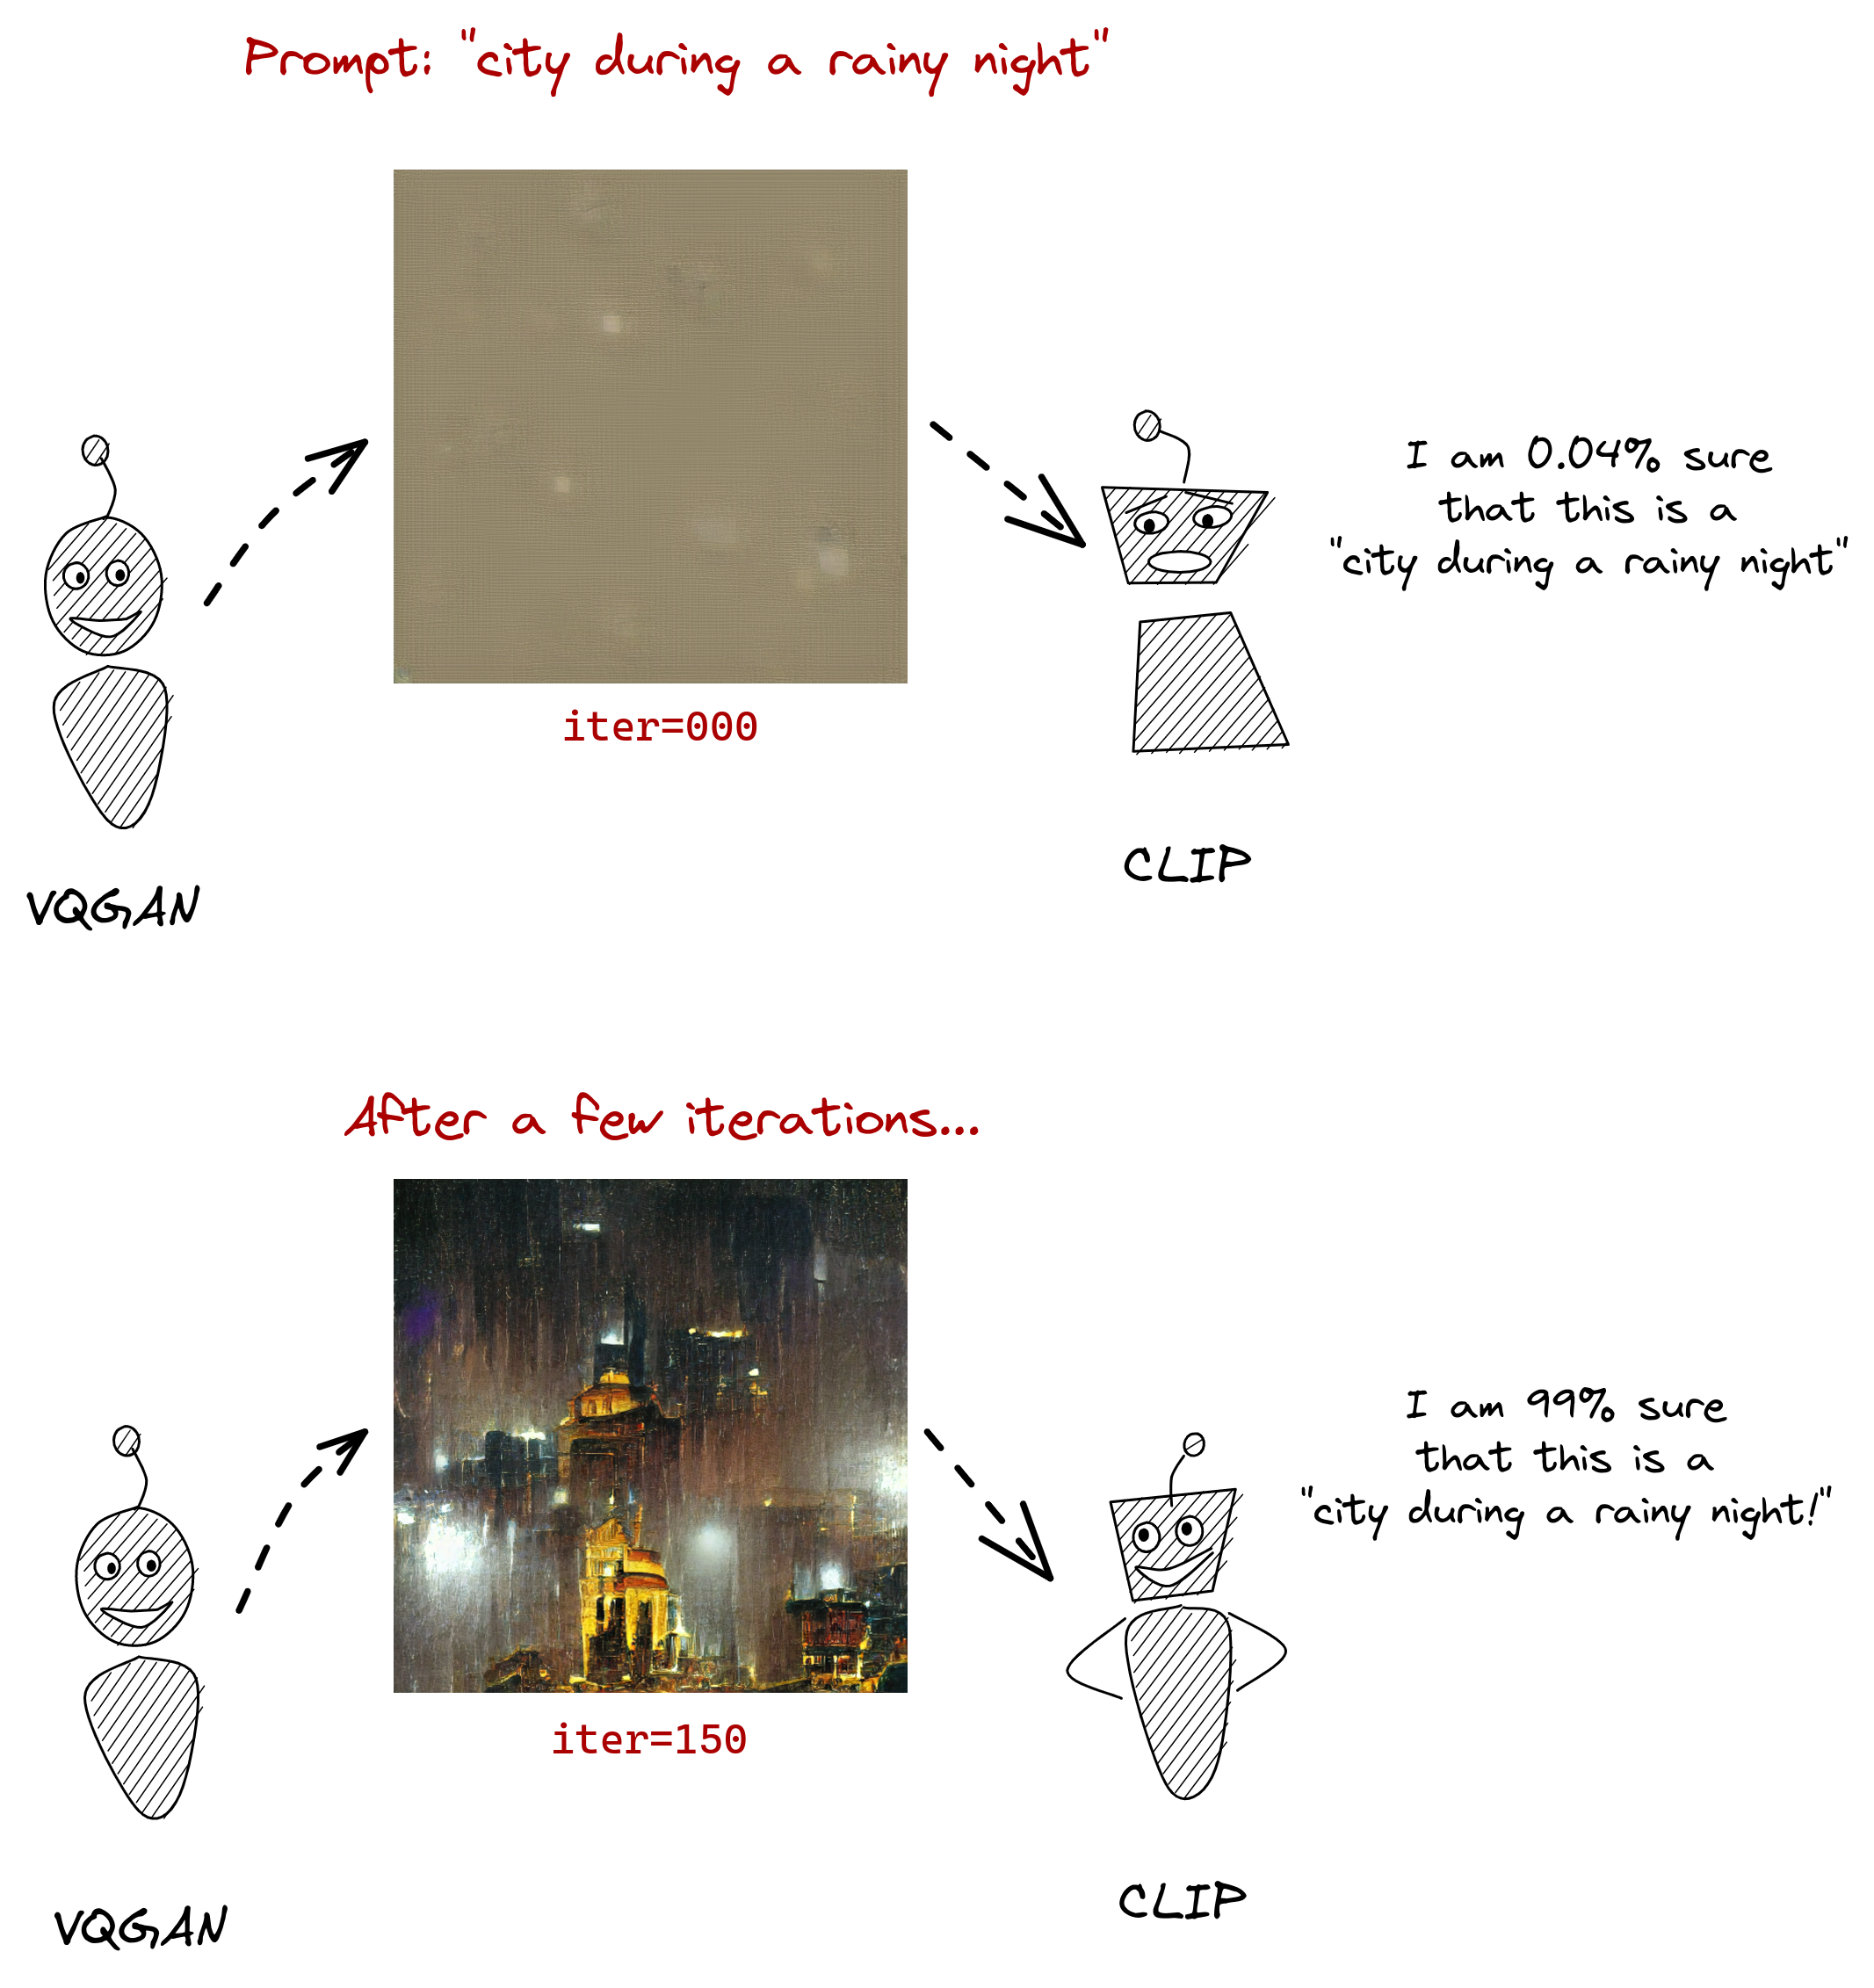
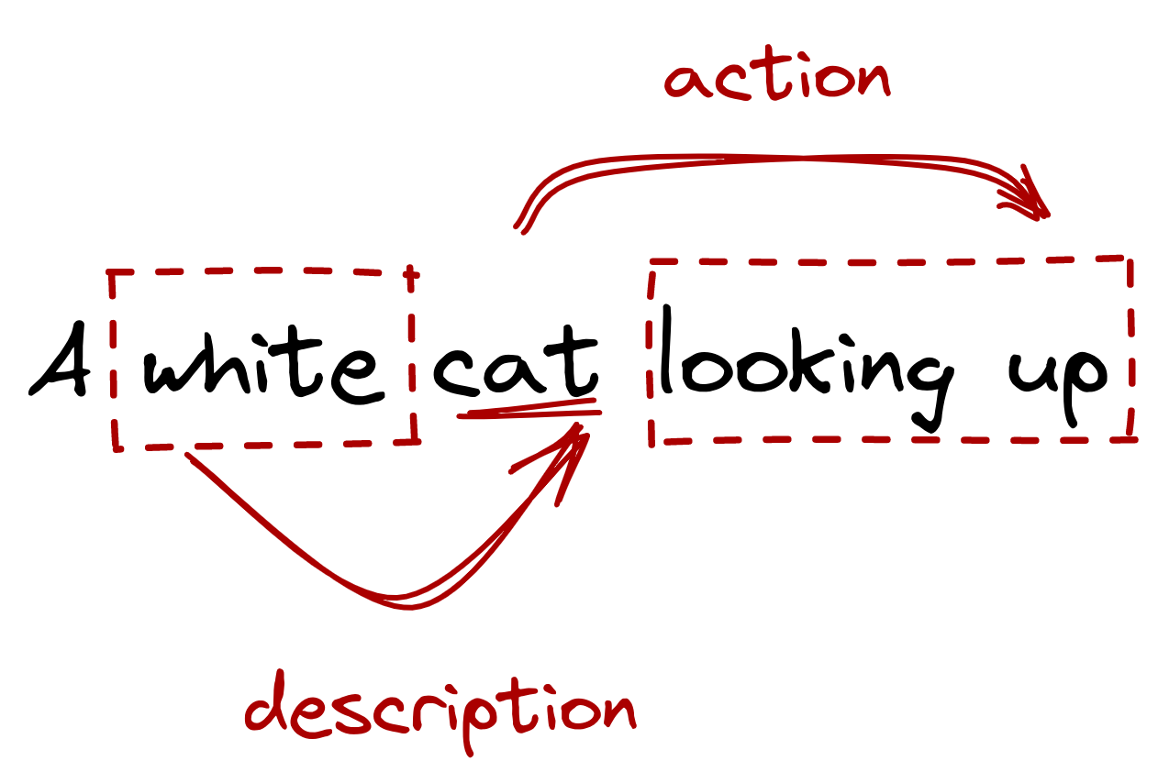
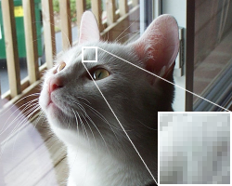
How VQGAN Works?
2
Task : Describe this picture ?
3
1
4

Slide 11
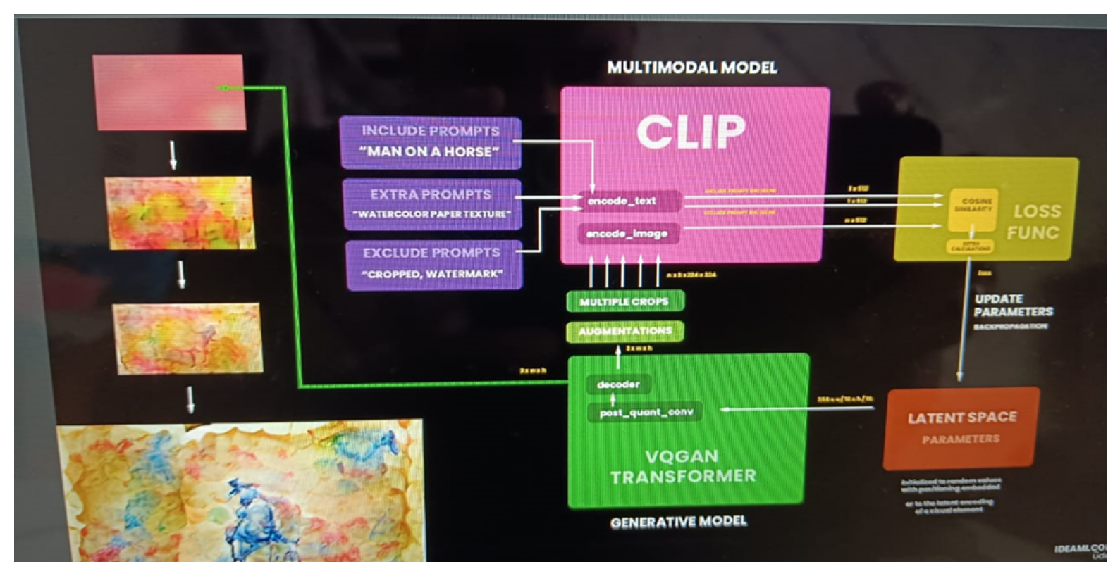
Model : CLIP + VQGAN
Input Text Prompt
CLIP Text Encoding
VQGAN Processing - VQGAN Encoder - Vector Quantization (VQ)
VQGAN Decoder
CLIP Image Encoder
Matching and Refinement
Loss Calculation and Backpropagation (Optional)
Iteration and Refinement
Output Image

Slide 12
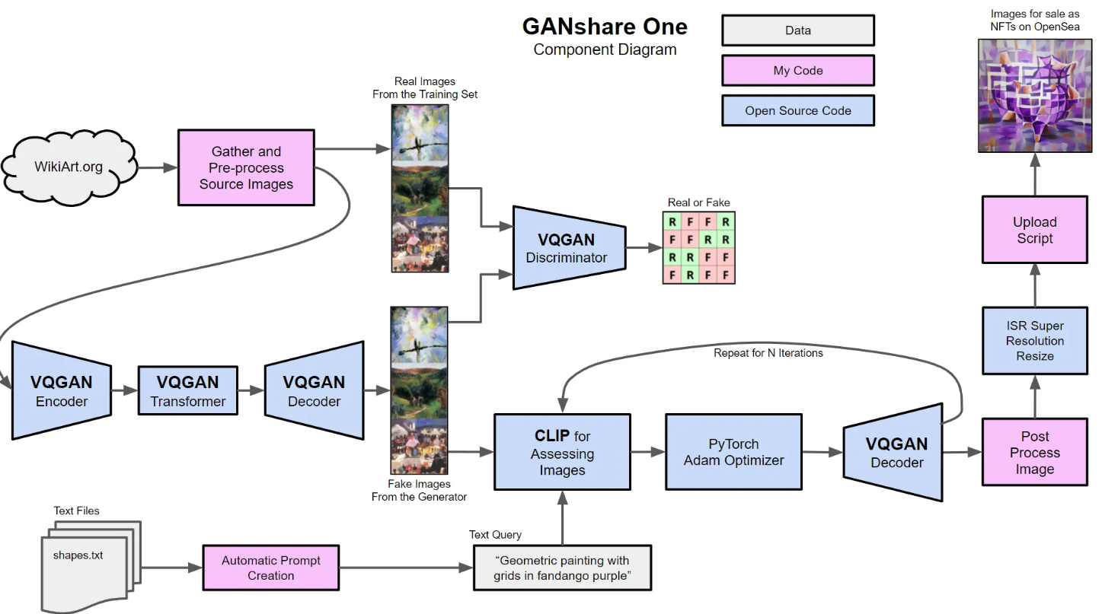

Slide 13
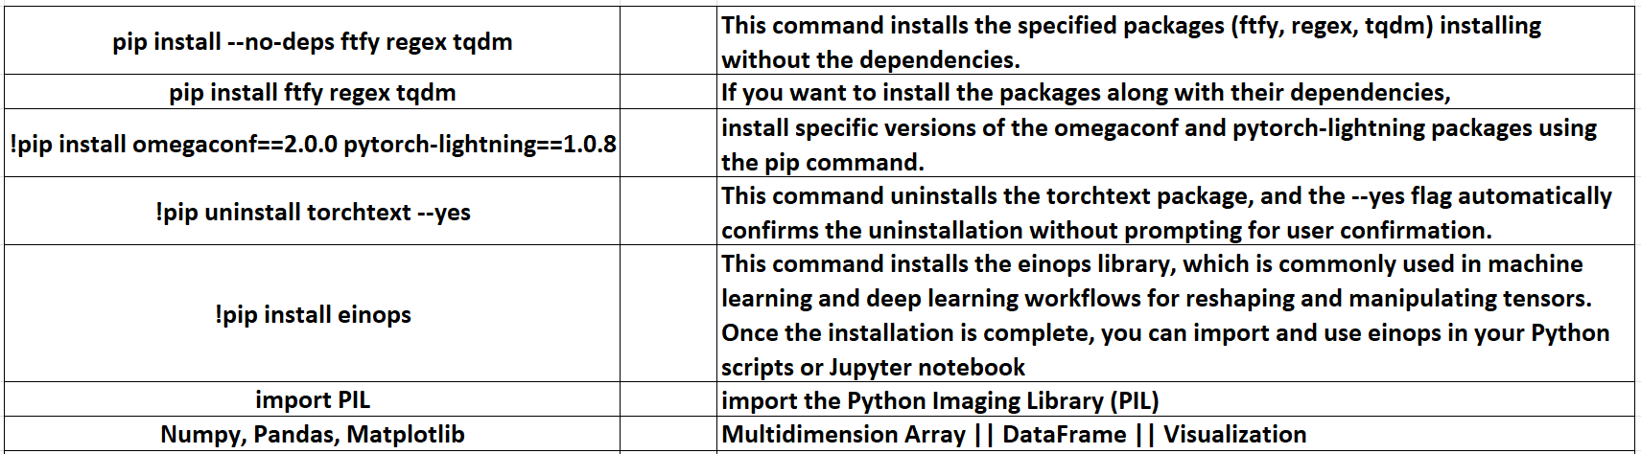
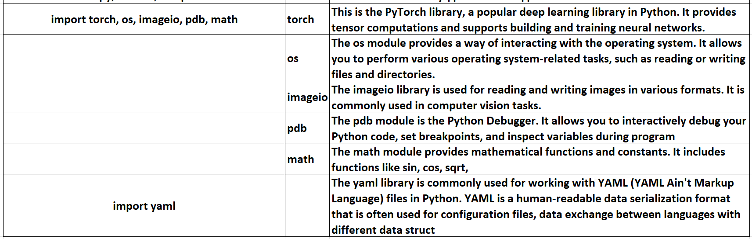
Code Snippet
1- GOOGLE COLAB SET UP :
2- DOWNLOAD 2 ARCHITECTURE➔ Let’s download 2 architecture from Github using ! Git clone (Clip & Vqgan)
3- INSTALLATION ➔ Install 2 architecture 2 folder created in the Colab
4- CREATE HELPER FUNCTION()
data.clip(-1, 1) + 2 5- SET UP CLIP MODEL Clip.load --- Argument ('ViT-B/32’ ) Jit =false -> Just-In-Time (JIT) compilation Clipmodel_eval() 6. SETUP TAMING TRANSFORMER %cd taming-transformers/ !mkdir -p models/vqgan_imagenet_f16_16384/checkpoints !mkdir -p models/vqgan_imagenet_f16_16384/configs
if len(os.listdir('models/vqgan_imagenet_f16_16384/checkpoints/')) == 0
!wget 'https://heibox.uni-heidelberg.de/f/867b05fc8c4841768640/?dl=1' -O 'models/vqgan_imagenet_f16_16384/checkpoints/last.ckpt’ !wget 'https://heibox.uni-heidelberg.de/f/274fb24ed38341bfa753/?dl=1' -O 'models/vqgan_imagenet_f16_16384/configs/model.yaml’ 7. PROCEED THE TAMING TRANSFORMER VQGAN ARCHITECTURE Error fixing : By importing the necessary modules
8.Create the class to declare the values that we are going to optimize
create class with parameter torch with module

Slide 14
9- Create few function to Encoding prompts
normalize = torchvision.transforms.Normalize((0.48145466, 0.4578275, 0.40821073), (0.26862954, 0.26130258, 0.27577711))
10 - CREATE CROPS need to send only single image many number of crops of images with augumentation , rotation, translation, you will give different variation of the image & clip can understand the various essence of the image for better image.
11. FUNCTION TO DISPLAY GENERATED IMAGES & CROPS Disply Image and Crops
12. OPTIMIZE THE PARAMETER BEFORE TRAINING THE LOOP Before training a model, it's crucial to optimize the hyperparameters and settings to ensure the training process is efficient and effective. Here are some common steps to optimize parameters before training:
13. TRAINING THE LOOP & RUN THE TRAINING LOOP TO CREATE THE TEXT PROMPT TO IMAGE FOR SINGLE IMAGE & MULTIPLE IMAGE
14. INTERPOLATING BETWEEN POINTS IN THE LATENT SPACE
Interpolating between points in the latent space is a common technique in generative models, especially in the context of variational autoencoders (VAEs) and generative adversarial networks (GANs). The latent space is a lower-dimensional representation of the input data that captures meaningful features. By interpolating between points in this space, you can generate new samples that smoothly transition from one point to another.
15. FINALLY WE CREATING VIDEO FROM TEXT PROMPT BY ADDING ALL THE PREVIOUS GENERATED IMAGE USING INTERPOLATIONS

Slide 15
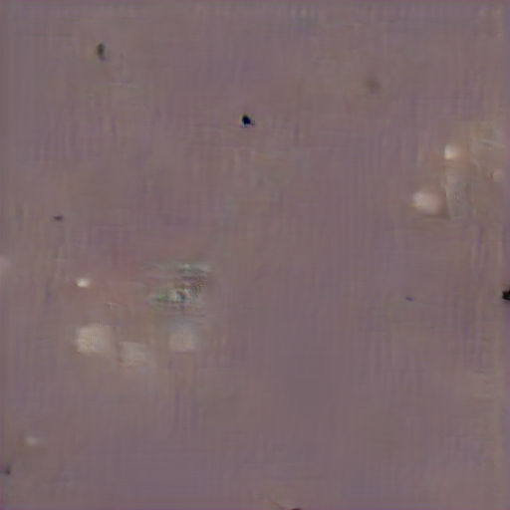
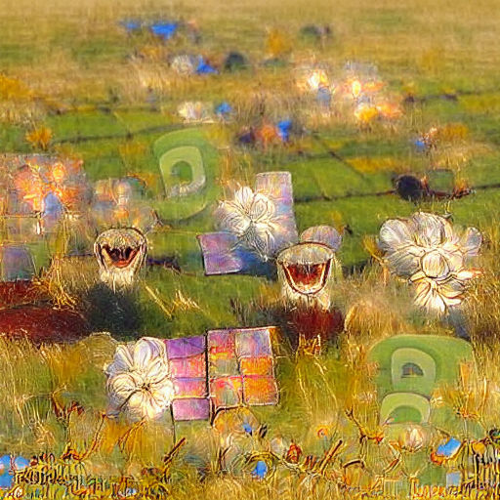
Image Generation
At first it’ll show a murky brown square (unless you’ve set an initial image), but as the system iterates, your image will gradually appear out of the gloom, like an AI-powered Polaroid.
300-400 iterations → good idea of how the final image → Further iterations may add more detail and clarity → No much difference above 1000
↑ Image at 1 iteration
↑ Image at 1000 iterations

Slide 16
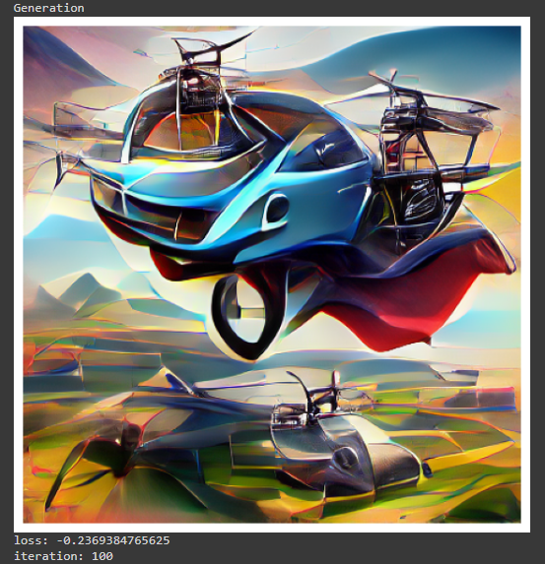
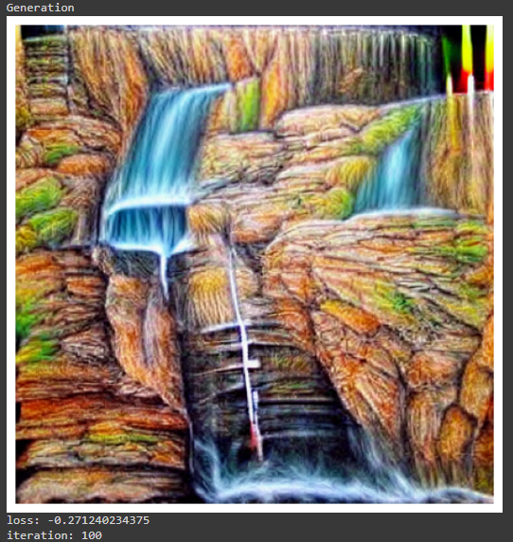
Prompt : “an autogyro flying car, trending on artstation”
Prompt : “A colored pencil drawing of a waterfall”

Slide 17
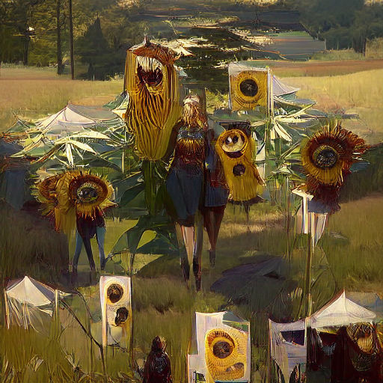
Better result from the prompt: “Tall happy sunflowers in sunlit field surrounded by trees | trending on Artstation”.
Writing good prompts
The quality of the result depends on the prompt. Our image wasn’t that great because the prompt didn’t contain enough detail – we left the settings on default. The more specific you are, the more you give the system to work with, and the better the result will be.
↑ At 1000 iterations, using the same seed.

Slide 18
Conclusion
Future Scope of Research for VQGAN + CLIP
The integration of VQGAN and CLIP offers promising potential for advancing generative modeling and multimodal understanding. Future research can focus on the following areas:
Improved Training Techniques:
Scalability and Efficiency:
Multimodal Integration:
Enhanced Image Manipulation:
Robustness and Generalization:
Ethical and Societal Implications:
Integration with Other Technologies:
Integration with Cloud AI Services:
VQGAN:
Generates high-quality images with efficient codebook representation.
CLIP:
Encodes and aligns text and images for robust understanding.
Together they create:
Detailed and contextually accurate images from text descriptions.
Images that match complex prompts with additional details.
Zero-shot learning capability:
Applies knowledge to new categories without retraining.
Potential applications:
Creative content generation.
Digital art.
Improved human-computer interaction.
Conclusion:
VQGAN + CLIP pushes boundaries of text-to-image synthesis.
Offers a powerful tool for generating semantically coherent images.

Slide 19
Reference :
Liu, X., Lin, Z., Zhang, J., Zhao, H., Tran, Q., Wang, X., and Li, H.: Open-edit: Open-domain image manipulation with open-vocabulary instructions. In: Computer Vision–ECCV 2020: 16th European Conference, Glasgow, UK, August 23–28, 2020, Proceedings, Part XI 16, pp. 89–106 (2020)
Ramesh, A., Pavlov, M., Goh, G., Gray, S., Voss, C., Radford, A., Chen, M., and Sutskever, I.: Zero-Shot Text-to-Image Generation. In: Meila, M., and Zhang, T. (eds.) Proceedings of the 38th International Conference on Machine Learning. Proceedings of Machine Learning Research, pp. 8821–8831. PMLR (2021)
Liu, X., Gong, C., Wu, L., Zhang, S., Su, H., and Liu, Q.: FuseDream: TrainingFree Text-to-Image Generation with Improved CLIP+GAN Space Optimization, (2021). arXiv: 2112.01573v1 [cs.CV]
Srivastava, N. and Salakhutdinov, R. Multimodal learning with deep boltzmann machines. In NIPS, 2012

